Slide 1


Music Recommendation System
MIT ADSP Capstone Project
December 2023
Han Hung
Notes:
For the capstone, I picked music recommendation systems.

Slide 2

Introduction
Recommendation Systems are important features for companies like Amazon, Netflix, and Spotify.
Help users navigate a large catalog of products.
Help personalize user experience by recommending products.
Notes:
Recommendation systems are the heart websites like Amazon, Netflix, Spotify, Yelp, just to name a few.
Recommendation systems help users navigate a large catalog of products, songs, or restaurants, by recommending products or songs that the user might be interested in.
They can help personalize a user’s experience by recommending products or songs that are relevant to the user.
In the case of music
it can create a personalized playlist of new songs based on the user’s history and others like them.
This can help increase sales or keep users engaged longer on the website.
The more time a user spends on the website, the better it is for the company.
Good recommendations can lead to higher sales.

Slide 3
The objective
Design a music recommendation system using data science.
Recommend top 10 songs that the user might like.
Notes:
Using Data Science methodologies, we'll design a music recommendation system.
Let's create a system to recommend the top 10 songs that a user might like.

Slide 4

The DAta
Raw dataset with 2 millions records.
Remove rows using the following criteria:
Users who have listened to less than 90 unique songs.
Songs with less than 120 unique users.
Users with play counts over 5.
Notes:
With 2 million rows in the original dataset, it may require a lot of computing resources to train the various models.
We will need to trim this down to a more manageable size.
We will filter the data based on the following criteria.
Remove:
Users who have listened to less than 90 unique songs.
Songs with less than 120 unique users.
Rows with play counts greater than 5.

Slide 5
Data analysis
There are still 118,000 records.
3,155 unique users.
563 unique songs.
1.8 million possible combinations.
7% of total possible combinations.
Notes:
We are left with around 118,000 records.
These contain
3,155 unique users
563 unique songs.
Combined, this will give us 1.8 million user-song combinations.
With 118,000 records, this represents less than 7% of the total possible combinations.
This gives us plenty of opportunities to make recommendations.

Slide 6
Models to build
Popularity-Based Recommendation System
User Similarity Based Collaborative Filtering
Item Similarity Based Collaborative Filtering
Model Based Collaborative Filtering
Cluster Based Recommendation System
Content Based Recommendation System
Notes:
We will build the following 6 models:
Popularity based recommendation system
User-User similarity based collaborative filtering
Item-Item similarity based collaborative filtering
Model-based collaborative filtering or Matrix factorization
Cluster based recommendation system
Content Based recommendation system
These are the typical models used to build recommendation systems
Netflix uses a variation of the SVD Matrix Factorization
Search engines use a content-based system.

Slide 7
Model metrics
RMSE vs. F1 Scores
RMSE measures accuracy of predictions.
F1 Scores measure percentage of relevant recommendations.
Notes:
Models are evaluated using RMSE, Precision, and Recall.
F1 is a combination of precision and recall or the harmonic mean of the two scores.
RMSE measures the accuracy of the predictions. For example, if a model predicted a play count of 2 for a user, how accurate is that prediction?
F1 Score measures how many recommendations are relevant to the user.
Between these two measurements, relevancy is more important than accuracy.
The more relevant songs that are recommended, the better the user experience, the longer the user will continue to stay.
This means that F1 Scores are more important than RMSE

Slide 8
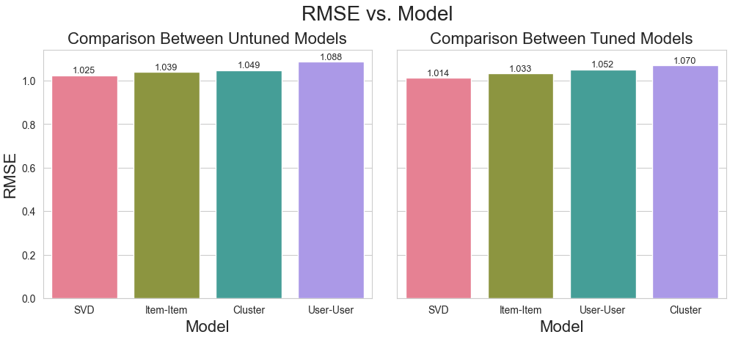
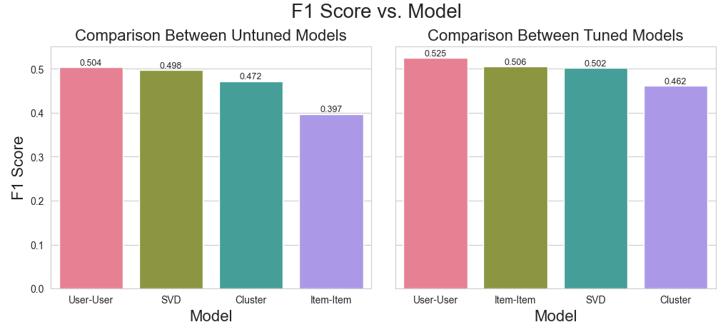
Model Comparison
F1 Scores
User-User Tuned
0.06 difference
Notes:
Earlier, I suggested building 6 different models to find the best one.
The popularity-based model does not really work since it does not offer personalized recommendations.
It ranks songs based on the average play counts.
All users will receive the same list of songs.
Content-based model does not work either since the text used to build the model is limited to the song’s title, album, and artist name.
Since some songs may have unique titles like ‘Luvstruck’ spelled with L-U-V or OMG, or artists may have unique names like Enimem or Foo Fighters, trying to find songs that match these may be challenging. At worst, the system may return all songs by the same artist or return a random selection if it cannot find a word match.
As a test, I searched for 'Yellow' by Coldplay.
This leaves us with the following:
User-User similarity collaborative filter
Item-Item similarity collaborative filter
Model Based Matrix Factorization
Cluster-Based Recommendation system
When we compare the RMSE and F1 scores for the various models, no model stands out
For the RMSE score, the difference between the best and worst performing model is around 1%.
For the F1 Score, the difference is around 6% for the tuned models.
The model with the best F1 Score is the user-user tuned model.
As mentioned in the previous slide, F1 score is a more important metric than RMSE score.
RMSE is still relevant because when predicting play counts, songs are ranked by predicted play counts.
The higher the play count, the higher the rank, the more it will be recommended.
While RMSE is not as important as F1 Score, it is still relevant because of that.

Slide 9
Proposal
No model is significantly better.
Tuned models scored better.
All models made different recommendations.
Start with one model and cycle through.
Retrain models to improve accuracy.
Notes:
Generally speaking, the tuned models have better metrics than their untuned counterpart.
The exception being the cluster-based recommendation system.
The tuned version performed slightly worse than the untuned version.
We can further experiment to see if adjusting the hyperparameters can improve results.
This applies to all the models.
However, I expect to see incremental improvements with tuning, so may not be worth spending much time.
Each model recommended a different list of songs.
There were some overlaps, but overall, the lists were different.
I recommended starting with one model and deploying it.
Then every month or so, deploy another model.
Cycle through all 4 models and see how well they perform using real-world data.
Did user engagement increase
Did users like the song recommendations
Retrain the models to improve the accuracy of the recommendations.

Slide 10
Risks
No system.
Bad recommendations.
Notes:
The risk of not deploying a recommendation system is that the user will be have to navigate a huge library of songs without any help.
This can be very challenging since typical users will tend to stay within their lanes.
This can get boring if they listen to the same songs or artists over and over again.
If the recommendation system suggests songs that the user does not like, this is also not a good outcome.
This may cause the user to abandon the service altogether.

Slide 11
Challenges Ahead
Test
Add Features
Retrain
Retune
Notes:
As mentioned earlier, no one model stood out.
We should deploy one model and cycle through them to test their performance using real-world data.
After some time, we should retrain these models using more data than the original dataset.
We should also retune the models to improve their scores.
We should also add more features like genre, mood, tempo to improve the recommendations.
After adding more features, the models should be retrained and redeployed to see how they perform.

Slide 12
Thank You

Slide 13
Appendix

Slide 14
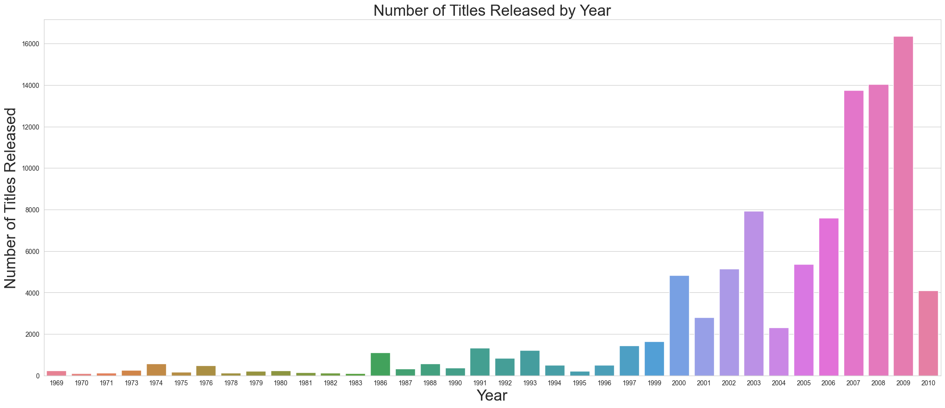
Songs released by year
1969 to 2010
More recent songs
Some gaps

Slide 15
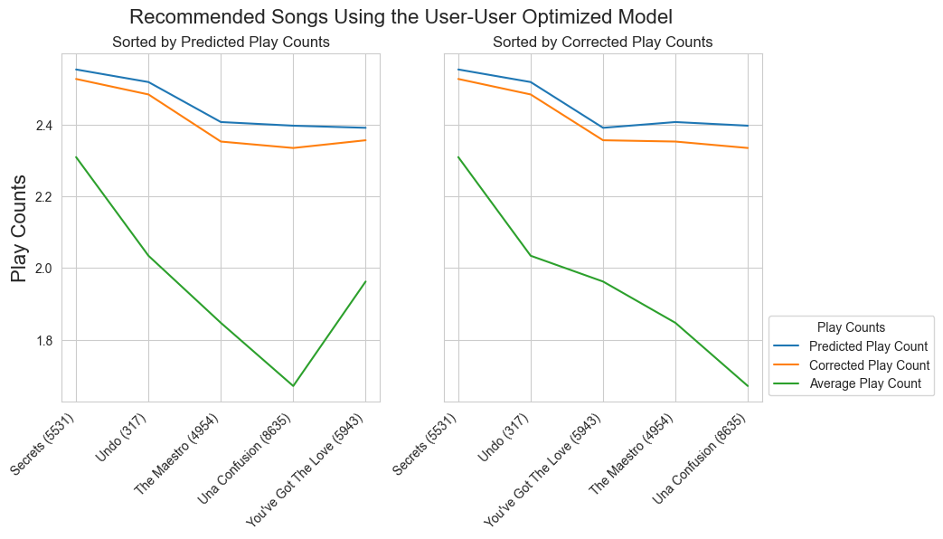

Correcting for bias
Songs with more unique users tend to be more accurate.
Songs with few listeners can be biased.
Need to subtract a normalization factor to correct for the bias.
Normalization factor used is $1/\sqrt{n}$ where n is the number of unique users.

Slide 16
Popularity Based Recommendation System
System is based on a song’s popularity.
Uses average of play counts.
Not useful since all users will get the same set of recommended songs.

Slide 17
User-User similarity collaborative filtering
Makes recommendations based on other users.
If two users have similar tastes, then chances are they will like each other’s music selections.
Model creates clusters of users that share similar preferences or taste in music.

Slide 18
Item-item similarity collaborative filtering
Similar to user-user similarity collaborative filtering.
Instead of clustering users, model identifies similarities between items.

Slide 19
Model based collaborative filtering
Looks at user-song interactions to build an interaction matrix.
Uses latent factors or hidden features while building the matrix.
More efficient than user-user or item-item models.
More robust when dealing with cold-start problems.

Slide 20
Cluster based recommendation system
Groups users into clusters based on preferences.
Combines the user-user and item-item collaboration filtering.
Users and items are assigned to clusters and co-clusters.

Slide 21
Content Based Recommendation System
Uses song title, release album, and artist name to build the recommendation system.
Computes word frequency and builds a matrix of songs with similar or related words.
Songs with common or related words will be ranked higher.
Used by search engines to build recommendations.
Not useful for songs because of the limited words in title, release album, and artist name.
Some songs or artists with unique names like Enimem or Luvstruck can throw the system off.

Slide 22
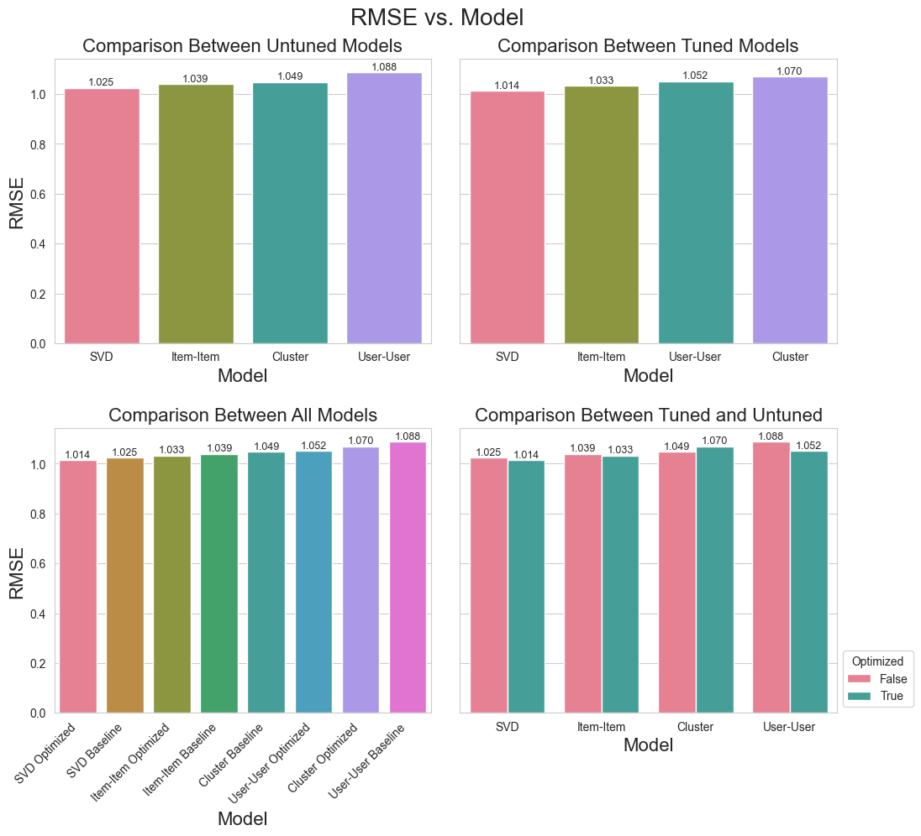
Rmse scores
Difference between high and low.
Tuned models better except for Cluster.

Slide 23
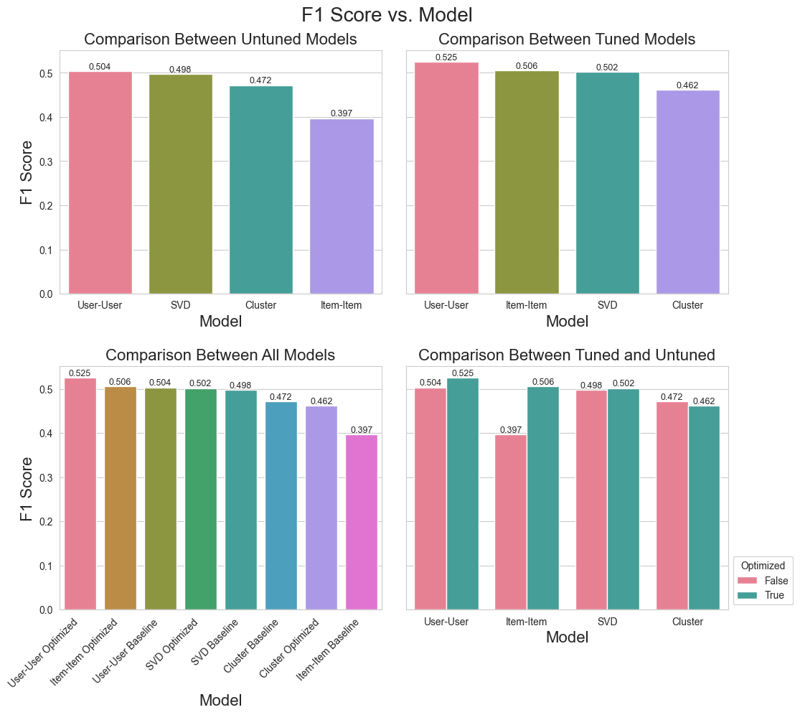
F1 Scores
Difference between high and low.
Tuned models better except for Cluster.
Notes:
F1 Score is the harmonic mean of the precision and recall scores

